Slide 1
SOWMIYA J
NM id: 465C6610499DF0DBFBA4E90C751B93E2
Madras Institute of Technology campus, Anna University
Final Project
STUDENT PERFORMANCE PREDICTION USING CSV DATASET

Slide 2
PROJECT TITLE
STUDENT PERFORMANCE PREDICTION (CSV dataset)
3/21/2024 Annual Review

Slide 3


AGENDA
The agenda of the project is to predict factors affecting student grades using classifiers and assess their performance.
This involves loading, exploring, and preprocessing the dataset, evaluating its performance and visualize grade distributions across different variables.
3/21/2024 Annual Review

Slide 4
PROBLEM STATEMENT
Develop a predictive model to identify factors influencing student grades using classifiers.
Utilize a dataset containing student attributes such as gender, nationality, grade ID, and performance metrics.
The aim is to accurately classify student grades (Low, Medium, High) based on these attributes.
Evaluate the performance of various classifiers including Decision Tree, Random Forest, Perceptron, Logistic Regression, and MLP Classifier, and determine the most effective approach for predicting student grades.
Additionally, explore the practical implications of deploying the predictive model in an educational setting and provide recommendations for future enhancements.
3/21/2024 Annual Review

Slide 5
PROJECT OVERVIEW
The project aims to predict student performance using machine learning classifiers. It utilizes a dataset containing student attributes and academic metrics.
The dataset is split into a training set comprising a majority of student records (e.g., 70-80%) and a smaller validation/test set for model evaluation.
The project aims to develop a robust predictive model that can offer insights into factors influencing student performance and support decision-making in educational institutions.
3/21/2024 Annual Review

Slide 6

WHO ARE THE END USERS?
Teachers and Instructors: They use the model to identify students who may require additional support based on predicted performance levels, enabling personalized intervention strategies.
School Administrators: Administrators allocate resources effectively, such as tutoring services or academic support programs, to improve overall student outcomes.
Educational Policy Makers: Policy makers utilize model insights to inform decisions on curriculum development, student assessments, and resource allocation, ensuring strategic improvements at institutional or governmental levels.
Parents and Guardians: They benefit from model insights to understand their child's academic strengths and weaknesses, facilitating tailored support to enhance their educational journey.
3/21/2024 Annual Review

Slide 7
YOUR SOLUTION AND ITS VALUE PROPOSITION
The value proposition lies in the accuracy and efficiency of the classification system, which offers benefits such as:
Enhanced Student Support: Accurately identifies students in need of assistance, facilitating targeted support interventions and improving academic performance.
Resource optimization: Efficiently allocates resources, such as tutoring services and academic support programs, maximizing their impact on student outcomes while minimizing wastage.
3.Informed Decision-Making: Provides educators and administrators with actionable insights for informed decision-making on curriculum development, assessments, and resource allocation, leading to improved educational outcomes.
4.Parental Engagement: Promotes transparent communication with parents and guardians by providing insights into student performance, fostering collaboration between home and school to support student success.
3/21/2024 Annual Review

Slide 8
THE WOW IN YOUR SOLUTION
The wow factor in our solution lies in its ability to accurately predict student performance levels and efficiently allocate resources, ultimately leading to improved academic outcomes and a more supportive educational environment. By leveraging advanced machine learning techniques and insightful data analysis, our solution empowers educators, administrators, and parents to proactively address students' needs and foster a culture of continuous improvement in education.
3/21/2024 Annual Review

Slide 9
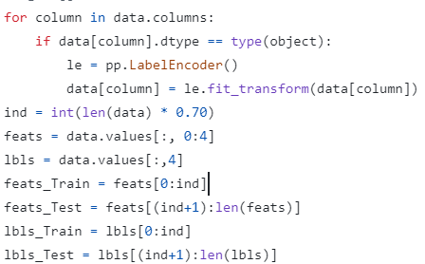
Data Preprocessing
3/21/2024 Annual Review

Slide 10


Classification Models and Model Evaluation:

Slide 11
THANK YOU !

